Slide 1
Software Evolution Process: Legacy System
By Sandip Khadka

Slide 2
Contents
Software Evolution Process.
Importance of Evolution Process.
Spiral Model of Evolution.
Legacy System.
Components of Legacy System.
Types of Legacy System.
Strategies for evolving legacy systems.
Legacy System Categories.
Problems Caused by legacy systems

Slide 3
Software Evolution Process
Software Development process does not end when system is delivered but continue through the lifetime of system.
After a system has been deployed, it needs to be change time to time due to factors like: requirement changes, environment changes, error or security breaches, improvements to system etc.
This time to time process is referred to as software evolution.

Slide 4
Software Evolution Process
Evolution processes depend on:
The type of software being maintained.
The development processes used.
The skills and experience of the people involved.
Proposals for change are the driver for system evolution. Change identification and evolution continue throughout the system lifetime.

Slide 5
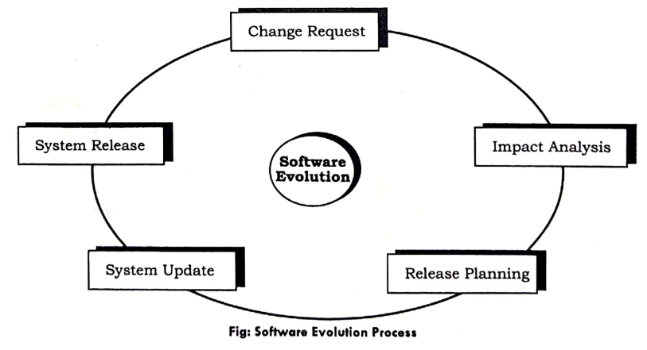
Software Evolution Process

Slide 6
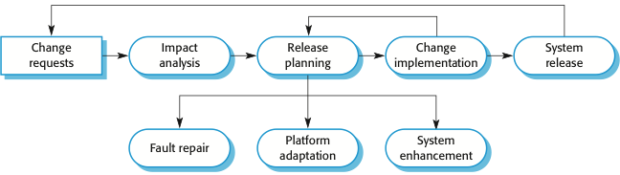
Software Evolution Process
Change implementation can be viewed as an iteration of the development process where the revisions to the system are designed, implemented and tested.

Slide 7
Software Evolution Process
A critical difference is that the first stage of change implementation may involve program understanding, especially if the original system developers are not responsible for the change implementation.
During the program understanding phase, we have to understand how the program is structured, how it delivers functionality and how the proposed change might affect the program.

Slide 8
Importance of Evolution Process
Organizations have huge investments in their software systems - they are critical business assets.
To maintain the value of these assets to the business, they must be changed and updated.
The majority of the software budget in large companies is devoted to changing and evolving existing software rather than developing new software.

Slide 9
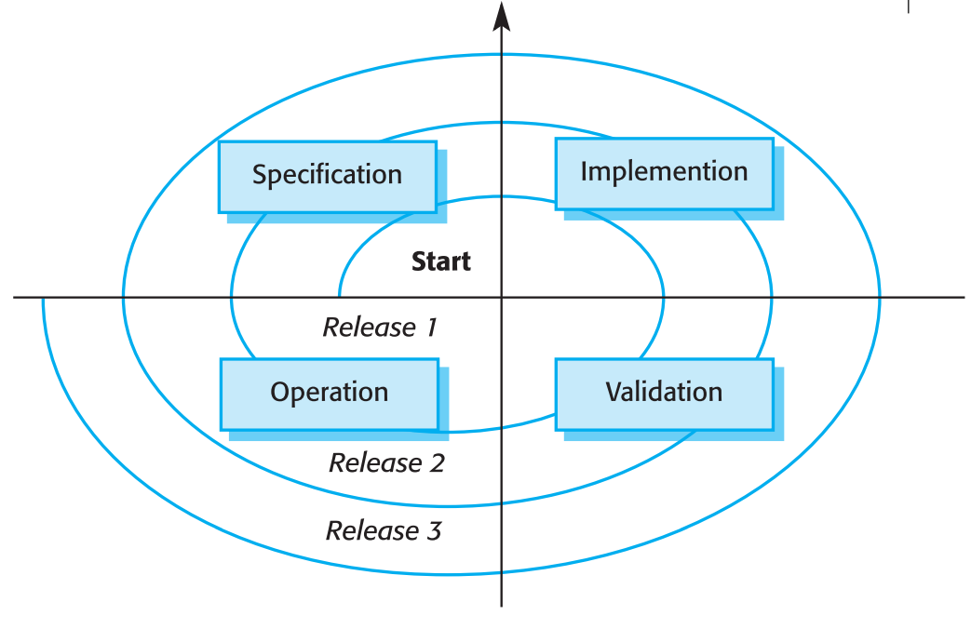
Spiral Model of Evolution
Fig: Spiral Model of Evolution

Slide 10
Legacy System
A legacy system is a computer system, programming language, software application, process or other technology that is outdated or that can no longer receive support and maintenance
But, it is essential for organizations or companies and can not be replaced or updated for different reasons.
Legacy system are socio technical computer based systems that have been developed in past using older technology.
They include application software together with business process, support software, system hardware etc.

Slide 11
For Example
In a bank, Banking management system was one of their earliest systems.
Organization policies and procedures may rely on this system.
If we replace the banking management system there could be a series business risk, if the replacement did not work properly.
So, they are maintained because it is too risky to replace.

Slide 12
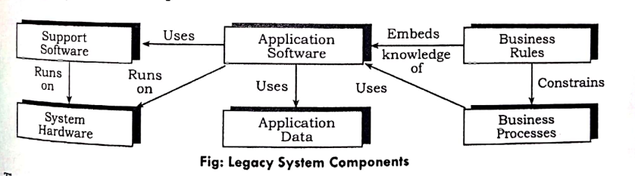
Legacy System Components

Slide 13
Types of Legacy Systems
End of Life (EOL):
EOL legacy systems are the ones that a vendors or developer has stopped supporting or offering updates for, or that are no longer purchasable.
Inability to Scale:
These legacy systems no longer have the scalability to support a business's growing data, performance or security needs.

Slide 14
Types of Legacy Systems
Heavily patched software:
A lot of legacy software is outdated software that has been extensively patched in the past to keep it up to date. Extensive patching -- and especially incomplete patching -- can make software more vulnerable to security breaches than modern applications and lead to its discontinuation.
No one knows how to maintain it:
A lot of legacy systems require outdated knowledge to maintain. This makes it difficult and costly to find an IT expert who knows how to maintain it.

Slide 15
Strategies for evolving legacy systems
Scrap the system completely: When the system is not making an effective contribution to business process then the system will be scrapped.
Reengineer the system to improve it’s maintainability: This method is valid when the system quality has been degraded by change and where a new change to the system is still being proposed.

Slide 16
Strategies for evolving legacy systems
Leave the system unchanged and continues with regular maintenance: This option is choosen when the system is still required but is fairly stable and the system users make relatively few change requests.
Replace all or part of the system with a new system: This option should be chosen when factors, such as new hardware, mean that the old system can not continue in operation or where off-the shelf systems would allow the new system to be developed at a reasonable cost.

Slide 17
Legacy System Categories
Low quality, low business value:
These systems should be scrapped
Low-quality, high-business value:
These make an important business contribution but are expensive to maintain. Should be re-engineered or replaced if a suitable system is available

Slide 18
Legacy System Categories
High-quality, low-business value:
Replace with COTS, scrap completely or maintain
High-quality, high business value:
Continue in operation using normal system maintenance

Slide 19
Problems Caused by legacy systems
Maintenance is costly: Maintenance is to expected with any system, but the cost of maintaining a legacy system is extensive. Maintenance keeps the legacy system running, but at the same time, the company is throwing good money after bad.
Data is stuck in silos: Data silos are a byproduct of legacy systems. Many older systems were never designed to integrate with each other in the first place, and many legacy software solutions are built on frameworks that can’t integrate with newer systems.

Slide 20
Problems Caused by legacy systems
Compliance is much harder: Organizations today must abide by strict sets of compliance regulations. As these regulations continue to evolve, a legacy system may not be equipped to meet them.
Security gets weaker by the day: A data breach can cost a company dearly, and legacy systems are more vulnerable to hackers than newer systems. Legacy systems by definition have outdated data security measures, such as hard-coded passwords.

Slide 21
Problems Caused by legacy systems
New systems don’t integrate: As a company matures, adding new systems is necessary to stay competitive in today’s world. But the older technology of a legacy system may not be able to interact with a new system.

Slide 22

Any Questions ?

Slide 23
Thank You

